Slide 1

Reinforcement learning (RL)
Made by CHAN SHUO KAI and IVAN TAY YEUN HENG

Slide 2
Introduction to RL
RL is a machine learning approach where an agent will learn to make decisions based on the environment.
There are many components to RL:
Agent: The learner/decision maker
Environment: The system that the agents
Actions: Choices made by the agent
State: Current situation or context (infinite)
Reward: Feedback from the environment, Positive/Negative

Slide 3
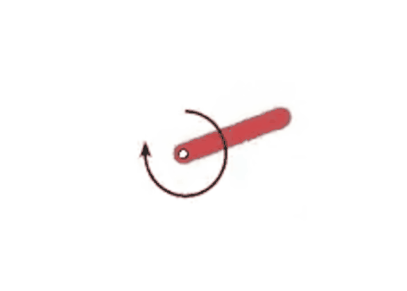
Objective for this assignment
We will be using OpenAI Gym’s Pendulum-v0
We want to balance the pendulum by exerting the optimal torque by applying deep Q-network (DQN) architecture.

Slide 4
DQN: DEEP Q-NETWORK
Q-Learning training involves updating network parameters to minimize the difference between the Q-values for all possible actions.
DQN approximates the Q-function using a deep neural network, providing the expected rewards for taking the action(s) in state(s).

Slide 5
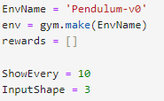
Initialising the Pendulum Environment
We will initialise the pendulum env and set up an array for our rewards.

Slide 6
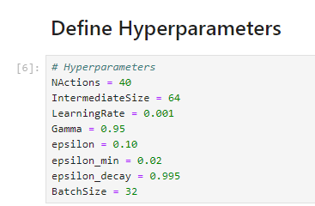
Base Model
We will be implementing a DQN model with untuned hyperparameters.
We will view the plot and view the average rewards allowing us to evaluate the performance.
This will allow us to improve on the model through tuning the parameters.

Slide 7
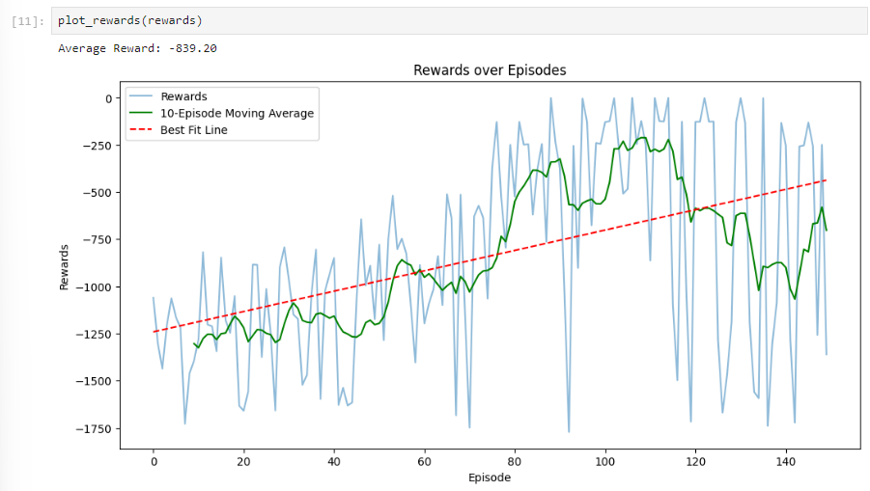
Base Model: Rewards Plot
We can see that the untuned model is extremely unstable and has an irregular graph. Especially at the end, the rewards become very volatile.
We now need to stabilise the training of the DQN to allow for a smoother rewards process.

Slide 8

Epsilon
Epsilon (ε) controls the exploration-exploitation balance. It represents the probability of choosing a random action rather than the best-known one. Initially high to encourage exploration, ε decreases over time to focus more on exploiting learned strategies.
We wish to strike a balance between exploitation and exploration but leaning towards exploitation.
This is because Epsilon at high values can provide erratic behavior leading to noisy/inconsistent performance.

Slide 9
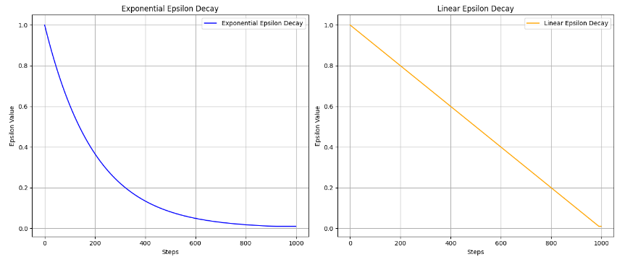
Epsilon Decay
Epsilon decay gradually reduces the exploration rate in reinforcement learning. Initially high to encourage trying different actions, it decreases over time, allowing the agent to focus more on exploiting known strategies while still exploring occasionally.
We have used two methods of epsilon decay: Exponential and Linear.

Slide 10
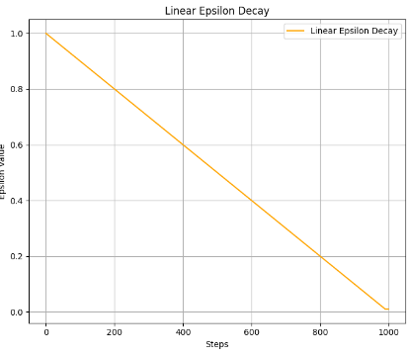
Epsilon Decay: Linear
Linear Decay: Epsilon decreases at a constant rate. For example, if epsilon starts at 1.0 and decays linearly to 0.1 over 1000 steps, it reduces by a fixed amount each step, providing a steady decrease.

Slide 11
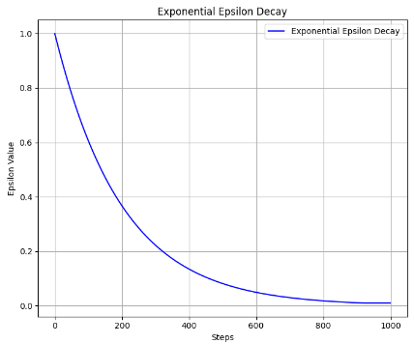
Epsilon Decay: Exponential
Exponential Decay: Epsilon decreases at a rate proportional to its current value, resulting in a rapid drop initially that slows down over time. For example, epsilon might decrease from 1.0 to a small value using a multiplicative factor in each step, leading to a curve that flattens out.
Exponential decay starts out fast and gradually levels off.

Slide 12

Epsilon Decay Choice: Exponential
We will be choosing exponential decay to implement in our DQN
It allows the agent to explore a lot at the beginning of training, when discovering diverse actions is crucial, and then gradually focus more on exploiting known strategies. This approach speeds up exploration early on and provides a smoother transition to more targeted learning, helping the agent adapt and improve its performance over time.
Implemented into OneEpisode function so it will decay the epsilon every episode.

Slide 13
Hyperparameter Tuning

Slide 14
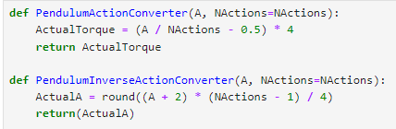
Actions to discretise the range of episodes (NActions)
Since we are using the OpenAI Gym’s Pendulum-v0, we will require less actions (20-30 discrete actions) compared to 40.
This is because we want to provide precise control over the torque applied while completing a simpler tasks.
20-30 is considered more actions meaning the agent can better fine-tune its actions to keep the pendulum upright.

Slide 15
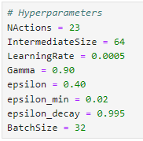
Parameters
The lowered learning rate will allow for a stabler learning process. The risk of overestimating Q values will be lowered, allowing the training to be smoother.
Gamma controls how much the agent values future rewards compared to immediate rewards. This means that a lowered value, allows the agent to be more responsive to current rewards, possibly allowing for quicker learning.
The increased epsilon rate allows the agent to increase in exploration rate (choosing random actions more often).
Inclusion of epsilon_min allows the agent to continue exploring after the decay preventing the agent from being overly greedy and missing out on potentially better strategies near end of training.

Slide 16
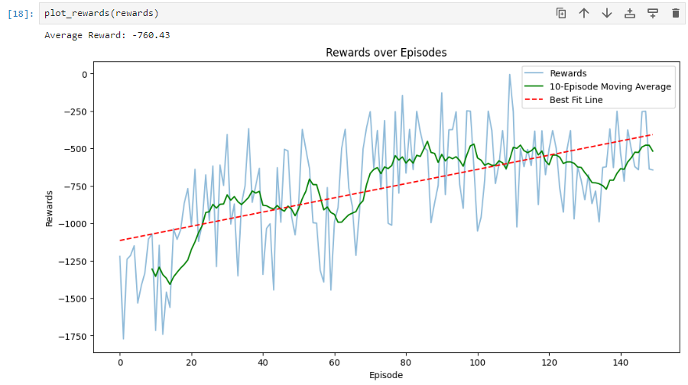
Tuned Model + Epsilon Decay (exponential)
We can see that the average rewards have become closer to zero which is ideal, meaning the rewards have been beneficial in the model’s learning.
We also observe that the graph is less sporadic and can improve while stabilizing at a steady pace.
We also notice the graph getting less stable near the end of 130 episodes, which is why we will stop at 15o episodes.

Slide 17
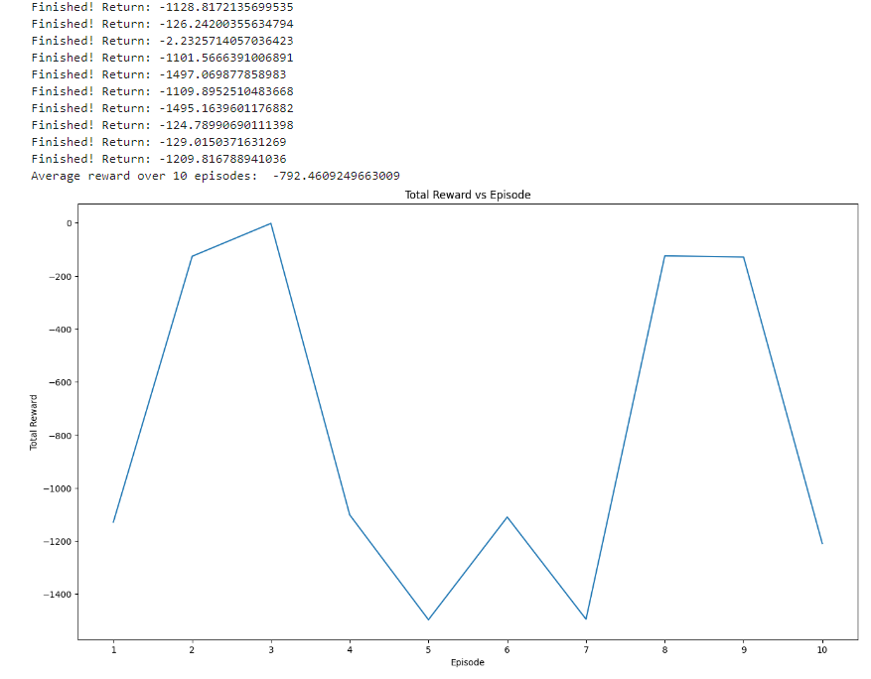
Evaluation of weights
We have saved the weights of each episode of our tuned model and selected the weight which is most stable and highest reward (weight 118)
After running the best weight 10 times, the plot shows that the results still vary and are not consistent.
This shows that the training itself has high variability due to the exploration strategy or even the environment itself.
There may also be other factors such as hyperparameter sensitivity.

